Slide 1
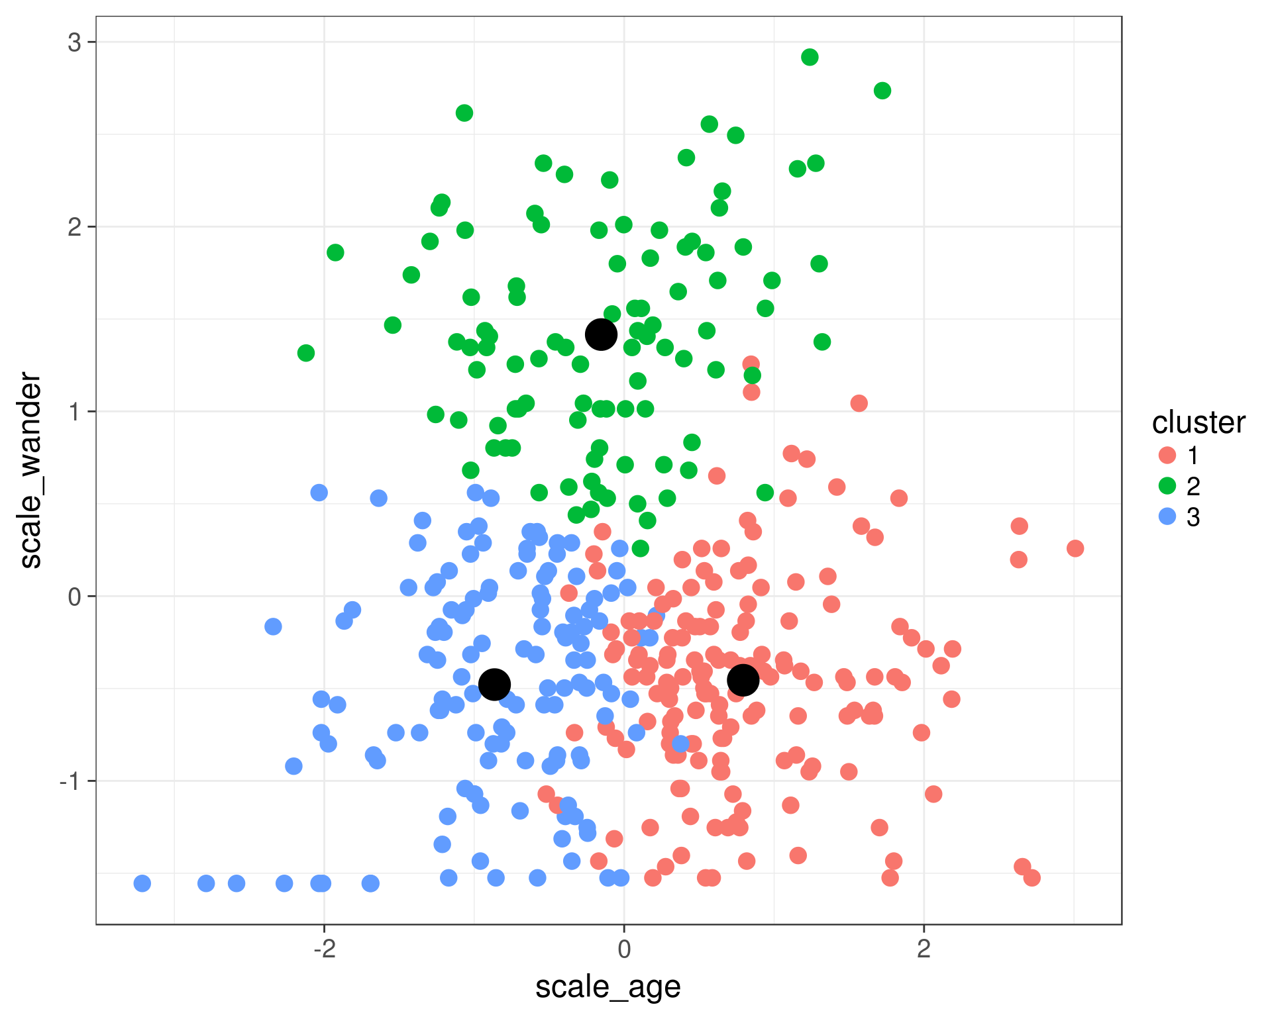
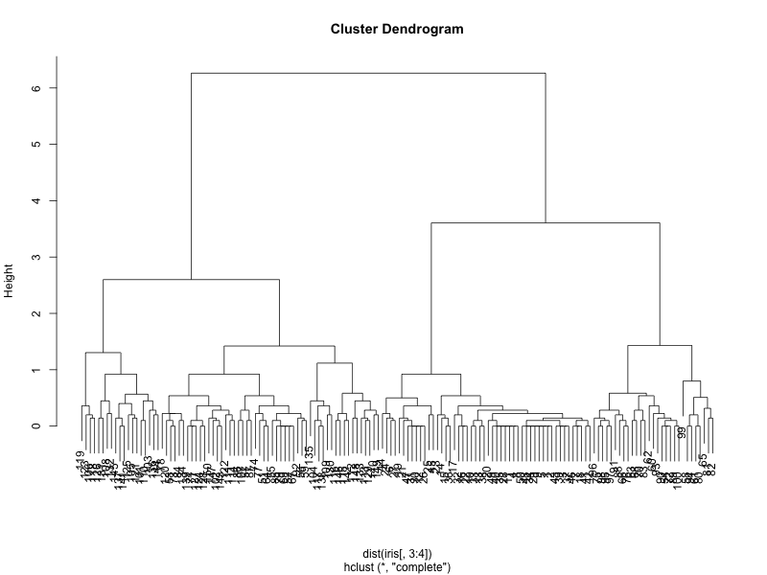
Clustering
Geog4300/6300
Jerry Shannon

Slide 2
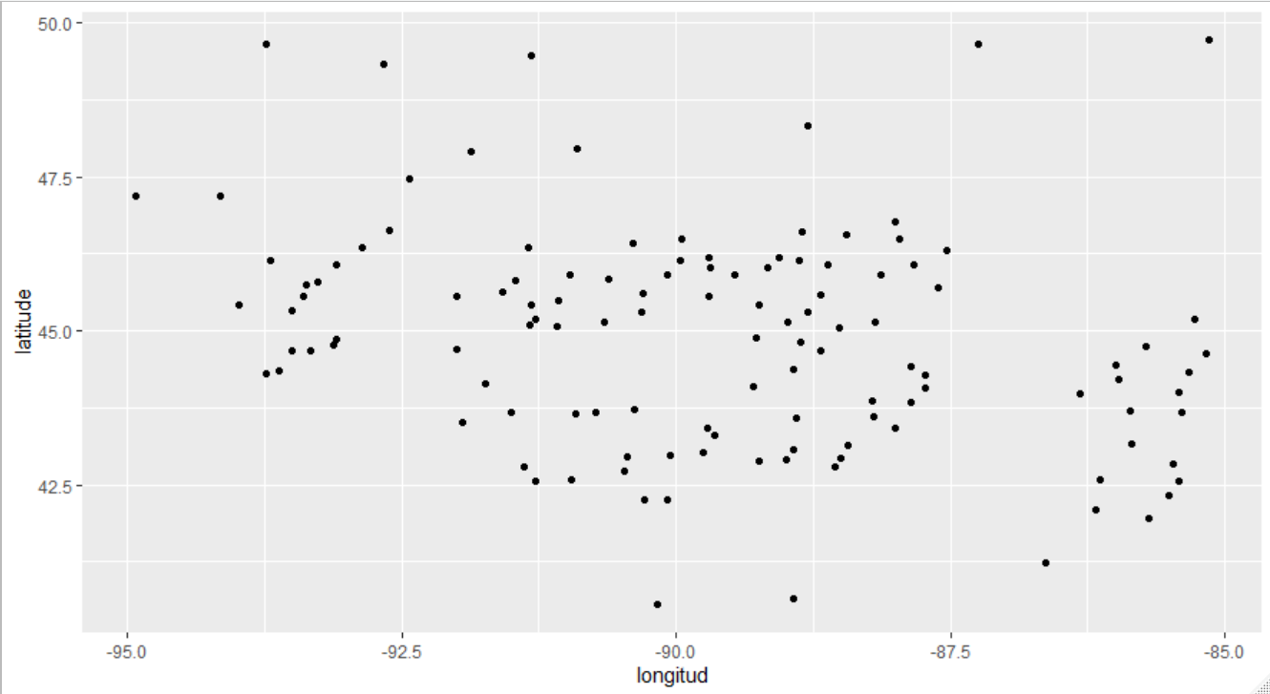
Let’s say you want to group some points. How should you do so?
Spring pollen data

Slide 3
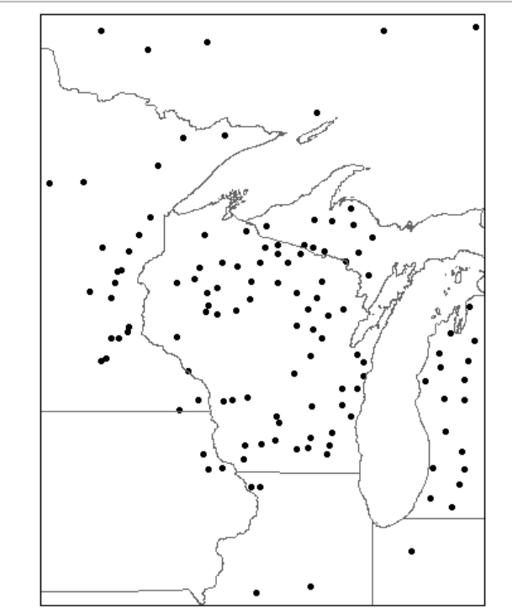
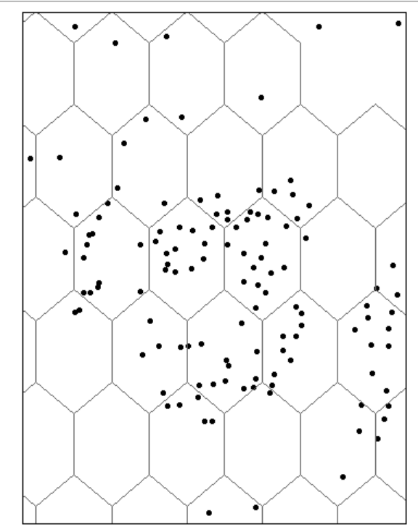
One solution—use preestablished boundaries, like states. Or use point pattern analysis.

Slide 4
Clustering techniques define groups based on their characteristics. Based on two or (many) more variables. Two simple options:
k-means clustering
hierarchical cluster analysis (hca)

Slide 5
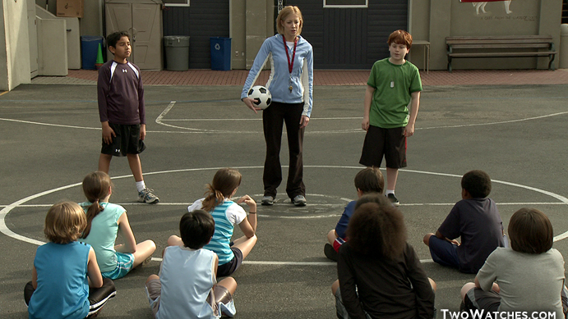
K-means
Picks a set number of “seeds” and then groups based on similarity.

Slide 6
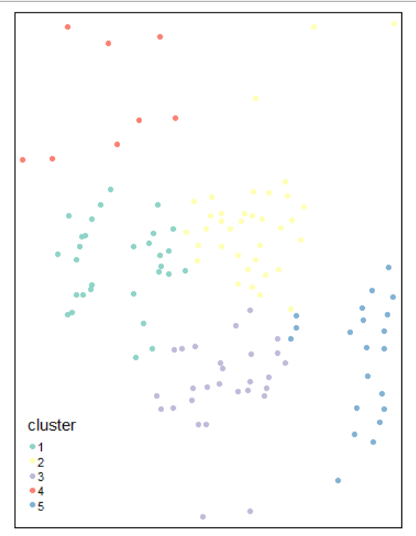
K-means
What if we group based just on geographic coordinates?

Slide 7
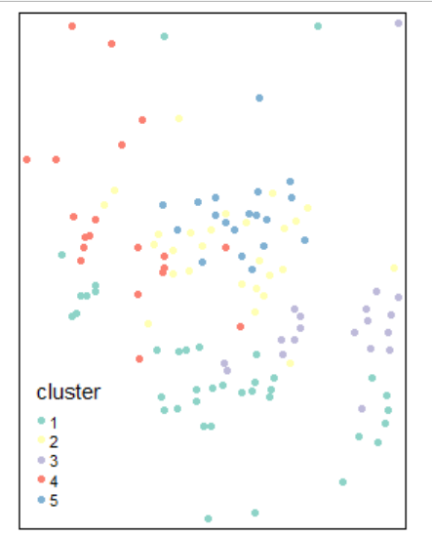
K-means
How about coordinates and birch pollen (Betula)?

Slide 8
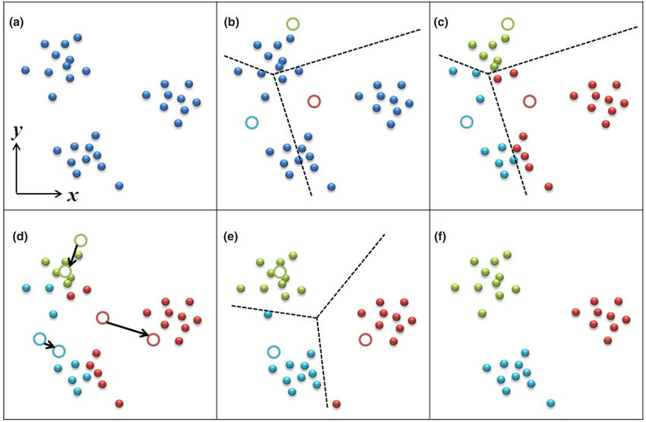
K-means
Main issue—very dependent on initial seeds. Changes every time.

Slide 9
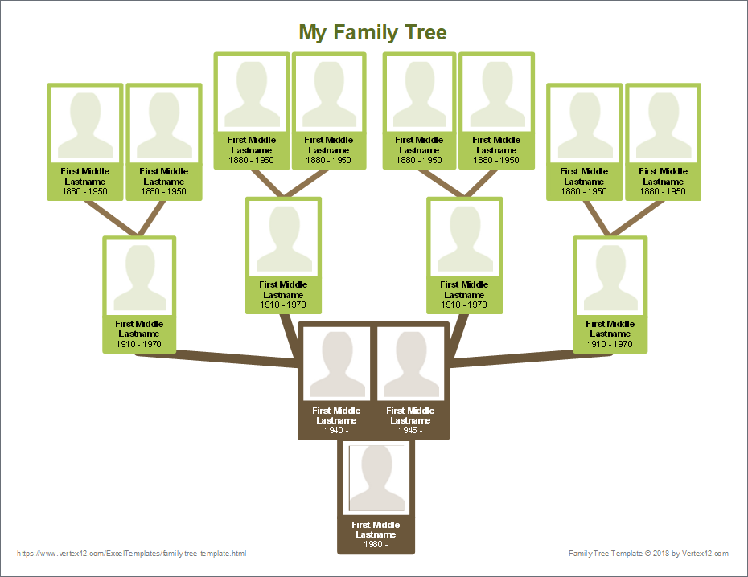
HCA
Creates a “distance” matrix between all observations and then groups at different levels.
Dendrogram

Slide 10
What counts as distance? Goal: Indentifying similarity across all variables
Sum of differences between values of continuous variables (or similar measure)
% matches for categorical variables
Also other options

Slide 11
How many clusters?
Can be arbitrary, based on researchers’ preference.
HCA dendrogram can identify potential clusters
Multiple algorithms can identify “optimal” cluster level

Slide 12
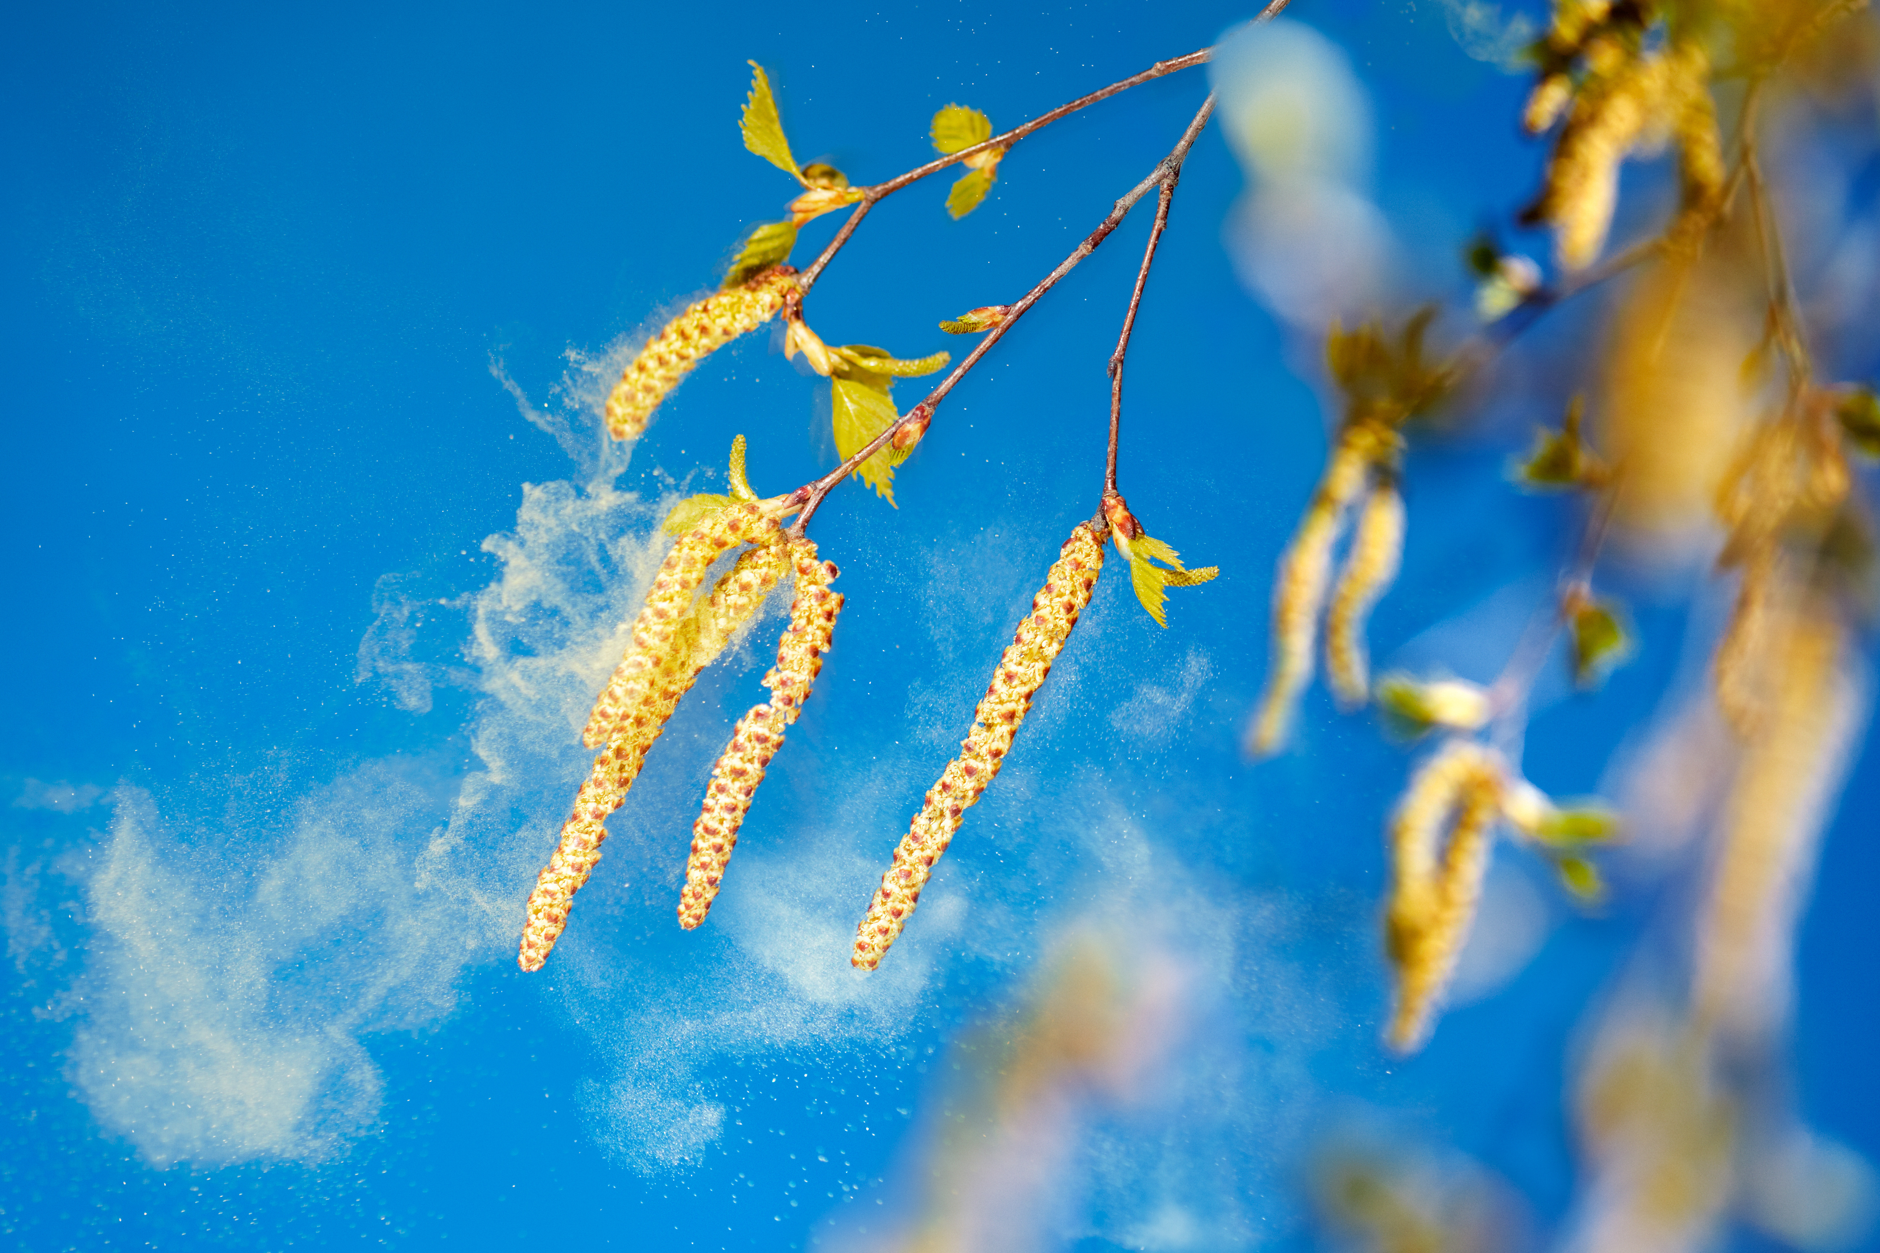
Try it in R!

